Slide 1
Fraud and Accounting
ALKAN PAMUKÇU
DEMİR ALPEREN YILMAZ

Slide 2

Definition
Fraud
Wrongful or criminal deception intended to result in financial or personal gain
Accounting fraud is intentional manipulation of financial statements to create a facade of a company's financial health

Slide 3

The Fraud Triangle
5% of the population will commit fraud regardless of the circumstances.
85% of the population will commit fraud given certain conditions
(Pressure, Opportunity and Rationalization)
*Cressey’s Fraud Triangle
10% of the population will not commit fraud under any circumstances.
Pressure
Financial or emotional force pushing towards fraud
FRAUD
Opportunity
Ability to execute plan without being caught
Rationalization
Personal justification of dishonest actions

Slide 4
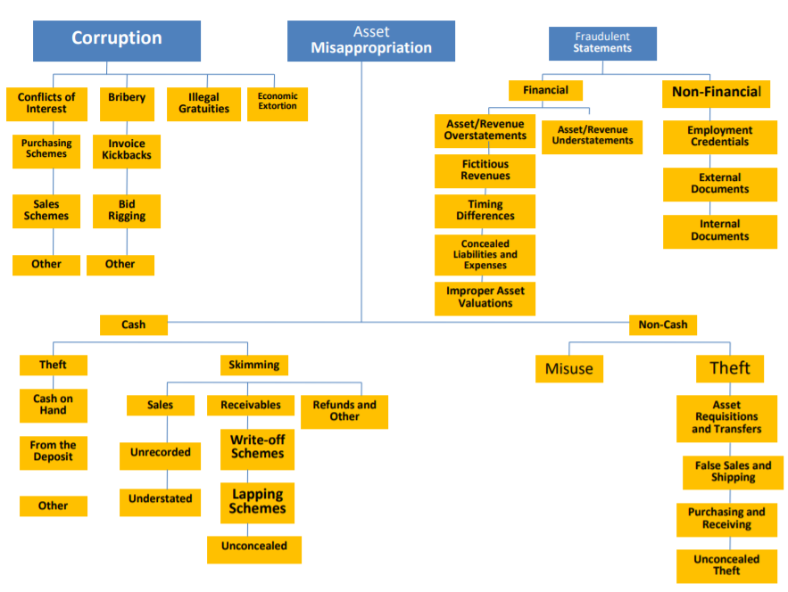
Asset/Revenue Overstatements
Asset/Revenue Understatements
Conflict of Interests
Bribery
Illegal Gratituities
Economic Extortion
Non Financial
Fictitious Revenues
Employment Credentials
Purchasing Schemes
Invoice Kickbacks
Timing Differences
External Documents
Sales Schemes
Bid Rigging
Improper Asset Valuations
Internal Documents
Concealed Liabilities/Expenses
Other
Other
Improper Disclosures
Cash
Non Cash
Theft of Cash on Hand
Skimming
Fraudulent Disbursements
Misuse
Larceny
Cash on Hand
Sales
Receivables
Refunds and Other
Asset Requisitions and Transfers
Billing Schemes
From the Deposit
Unrecorded
Write-off
Schemes
Payroll Schemes
Expense Reimbursement Schemes
False Sales and Shipping
Other
Understated
Lapping
Schemes
Purchasing and Receiving
Unconcealed
Check Tampering
Register Disbursements
Unconcealed Larceny

Slide 5
CORRUPTION
Conflict of Interests
When an employee has an undisclosed personal interest in a transaction
Purchase Scheme: The overbilling of a company for goods or services by a vendor in which an employee has an undisclosed ownership or financial interest
Sales Scheme: The underselling of company goods by an employee to a company in which the employee maintains a hidden interest
Bribery
The offering, giving, receiving, or soliciting of a thing of value to influence a business decision
Kickback scheme: An illegal payment intended as compensation for favorable treatment or other improper services
Bid-rigging scheme: Occurs when an employee fraudulently assists a vendor in winning a contract through the competitive bidding process
Illegal gratuities
Something of value given to an employee to reward a decision after it has been made, rather than influence it before the decision is made
Economic Extortion
Occurs when an employee demands payment from a vendor for decisions made in the vendor’s favor. Refusal to pay the extorter results in harm to the vendor

Slide 6
ASSET MISAPPROPRIATION
Using company property or cash without authorization, or stealing cash and property
CASH
Theft of Cash on Hand
Perpetrator misappropriates cash kept on hand at the victim organization’s premises (e.g., employee steals cash from a company vault)
Skimming
Sales
Unrecorded: The transaction is not recorded
Understated: The transaction appears as it is done for a lower amount than what the perpetrator actually collects
Receivables
Write-off scheme: Once an account has been written-off, the employee has the opportunity to keep the funds for himself since companies typically do not keep track of old, written-off accounts receivable
Lapping Scheme: The recording of payment on a customer's account sometime after the payment has been received
Unconcealed: There is no attempt to adjust the books and records to conceal the action.
Refunds
Returning goods ineligible for refund to a retailer in exchange for money or other goods

Slide 7
Fraudulent Disbursements
On-book fraud schemes, meaning that cash (checks) leaves the entity fraudulently
Billing Schemes: The perpetrator causes the victim organization to buy goods or services that are nonexistent, overpriced, or not needed by the organization.
Payroll Schemes: An employee fraudulently generates overcompensation on his behalf
Expense Reimbursement Schemes: Requesting reimbursement for a personal expense by claiming that the expense is business related.
Check Tampering: An employee either prepares a fraudulent check for his own benefit or converts the check to his or her own benefit
Register Disbursements: An employee uses false refunds and false voids for theft
NON-CASH
Misuse
The use of company’s assets improperly, mostly for personal uses that are irrelevant to business
Larceny
Asset Requisitions and Transfers: An employee uses the asset for personal use by inducing the asset to be moved
False Sales and Shipping: Fraudsters create false shipping documents and false sales documents to make it appear that missing inventory was not actually stolen but was instead sold
Purchasing and Receiving: Employees cause their company to purchase merchandise that the company does not need
Unconcealed Larceny: The theft of the propery without the concern of concealing it

Slide 8
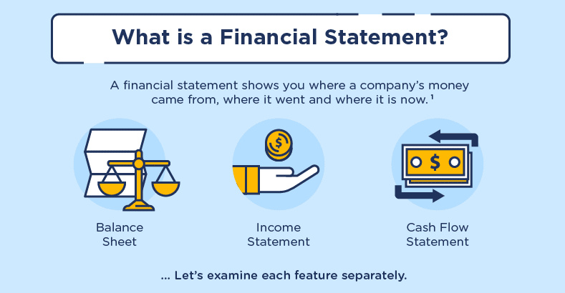

Slide 9

Who commits Financial Statement Fraud?
Senior Management (CEO, CFO, etc). CEO was involved in 72 percent of the frauds whereas the CFO was involved in 43 percent. Either the CEO or the CFO was involved in 83 percent of the cases (Wells, 2005,288)
Mid- and lower-level employees. These employees are responsible for subsidiaries, divisions or other unit. The main reason is to conceal their poor performance or to earn bonuses based on the higher performance (Wells 2005, 288)

Slide 10


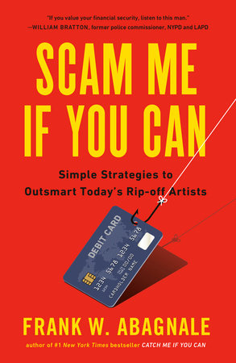
«We Cook Books
Why It is Committed?
To Buy More Time»
TO…
quietly fix current problems
→ obtain or renew financing
→ inflate company share prices or exercise stock options at a profit
→ obtain bonus pay linked to company performance
→ encourage investment through the sale of stock
demonstrate increased earnings per share thus allowing increased dividends
→ cover inability to generate cash flow
→ dispel negative market perceptions
→ receive higher purchase prices for acquisitions
→ demonstrate compliance with financing covenants
→ meet company goals and objectives

Slide 11
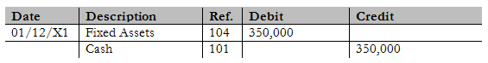
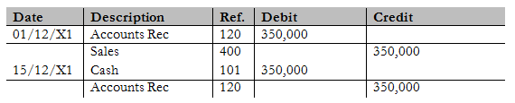

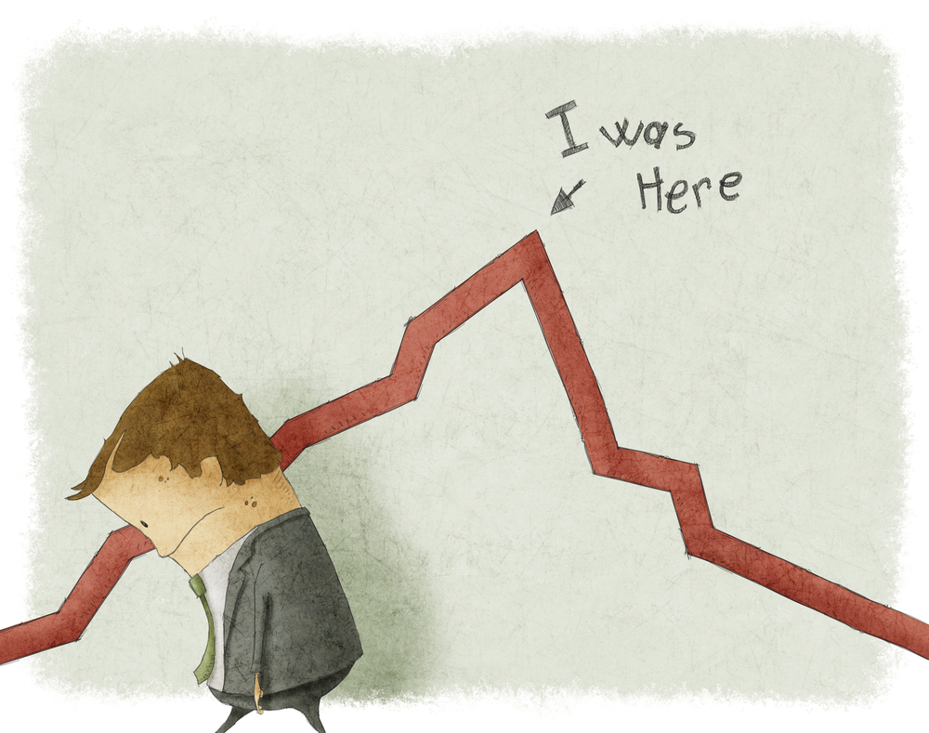
FICTITIOUS REVENUES
→ Recording of sales that did not ocur
→ Fictitious sales to existing or fictitious customers
→ The sale is reversed in the next period
TIMING DIFFERENCES
→ Includes improper revenue recognition
Recording of expenses or revenues in improper periods
Channel stuffing
Long term contracts
Recording expenses in the wrong period

Slide 12
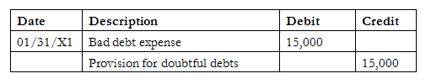

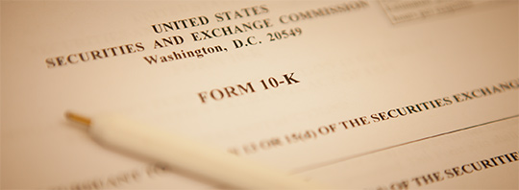
IMPROPER ASSET VALUATIONS
→Improper asset valuation take the form of one of the following classifications;
Inventory valuations
Accounts receivable
Business combinations
Fixed assets
CONCEALED LIABILITES AND EXPENSES
→ The company appears more profitable than it actually is
Liability/expense omissions
Improperly capitalising costs rather than expensing them
Failure to disclose warranty costs and provisions
IMPROPER DISCLOSURES
→Financial statements should include all necessary information to prevent any shareholder from being misled

Slide 13



Red Flags Associated with Financial Statements Fraud
Domination of management by a single person or small group
Ineffective Communaction
Recurring Negative Cash Flows
Rapid Growth or Unusual Profitability
Restrictions On Auditors
Significiant, Unusual or Highly Complex Transactions
Significant Related Party Transactions
Unusual Financial Ratios
Frequent Unusual Wrong Classifications
History of Violations of Laws and Regulations
The list goes on as it includes different signs or warning:
Inventory Shrinkage
Missing Documents
Multiple Payments
Spikes in Invoice Volume
Frequent Complaints
Excessive Number of Adjusting Entries
Lifestyle Changes

Slide 14



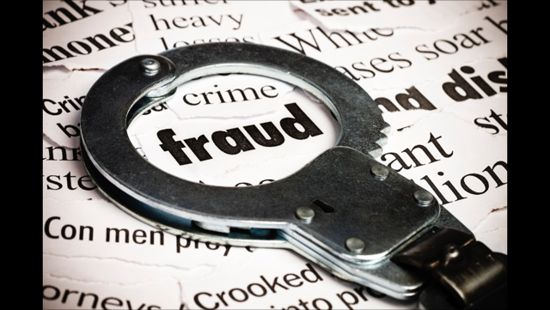



Detection of Financial Statements Fraud
Vertical analysis
Horizontal analysis
Ratio analysis
Cash Flow Analysis
How to Prevent Financial Statements Fraud
Internal Controls
Segregation of Duties
Education of Employees and Managamenet
Strong Control Environment
Audits
Independent Third Party
Management Reviews
Written Statement

Slide 15




Top Accounting Scandals
Enron Scandal (2001)
WorldCom Scandal (1998)
Waste Management Scandal (1998)
Tyco Scandal (2002)

Slide 16


Slide 17
Foundation
Houston
Natural Gas
InterNorth

Slide 18

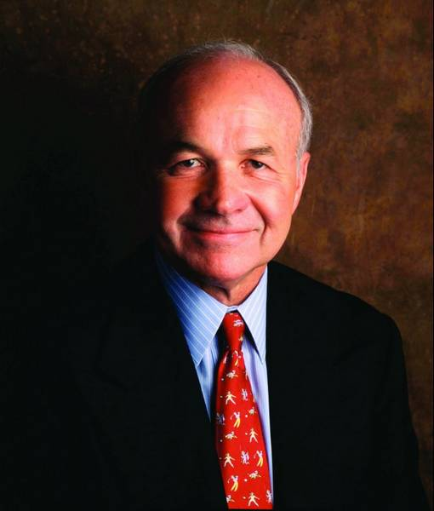
Foundation
Ken Lay became the CEO of the new company.
Traditional Businesses
Electricity
Natural Gas
Oil
Communications
Pulp and Paper

Slide 19
Trading Activities
Deregulation of the industry
Ken Lay hired Jeffrey Skilling.
Establishment of a “Gas Bank”
Providing funding for small gas producers,
In exchange for natural gas.
Volume Production Payments (VPP)

Slide 20
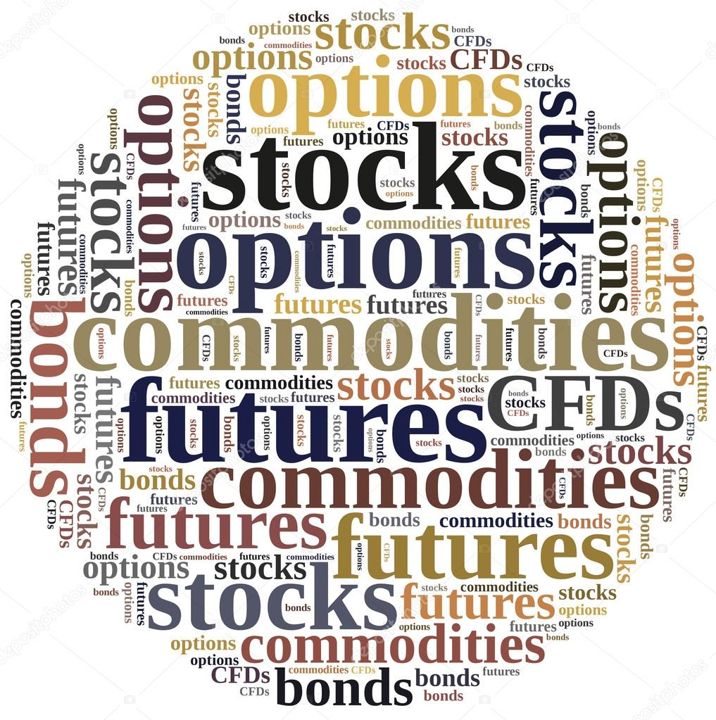
Use of Derivatives
Lobbying for exemptions from regulations.
Transformation of energy to financial instruments.
“Stock market” for commodities.
Oil, gas, electricity, weather, bandwidth etc.

Slide 21



Mark-to-Market Accounting
Accounting for the “fair value” of assets/liabilities.
Booking potential future profits on the day a deal was signed.
Forecasting the future price and calculating NPV. “Marking-to-Enron”.
First non-financial firm employing this approach.
Arthur Andersen signed off and the SEC approved it.

Slide 22
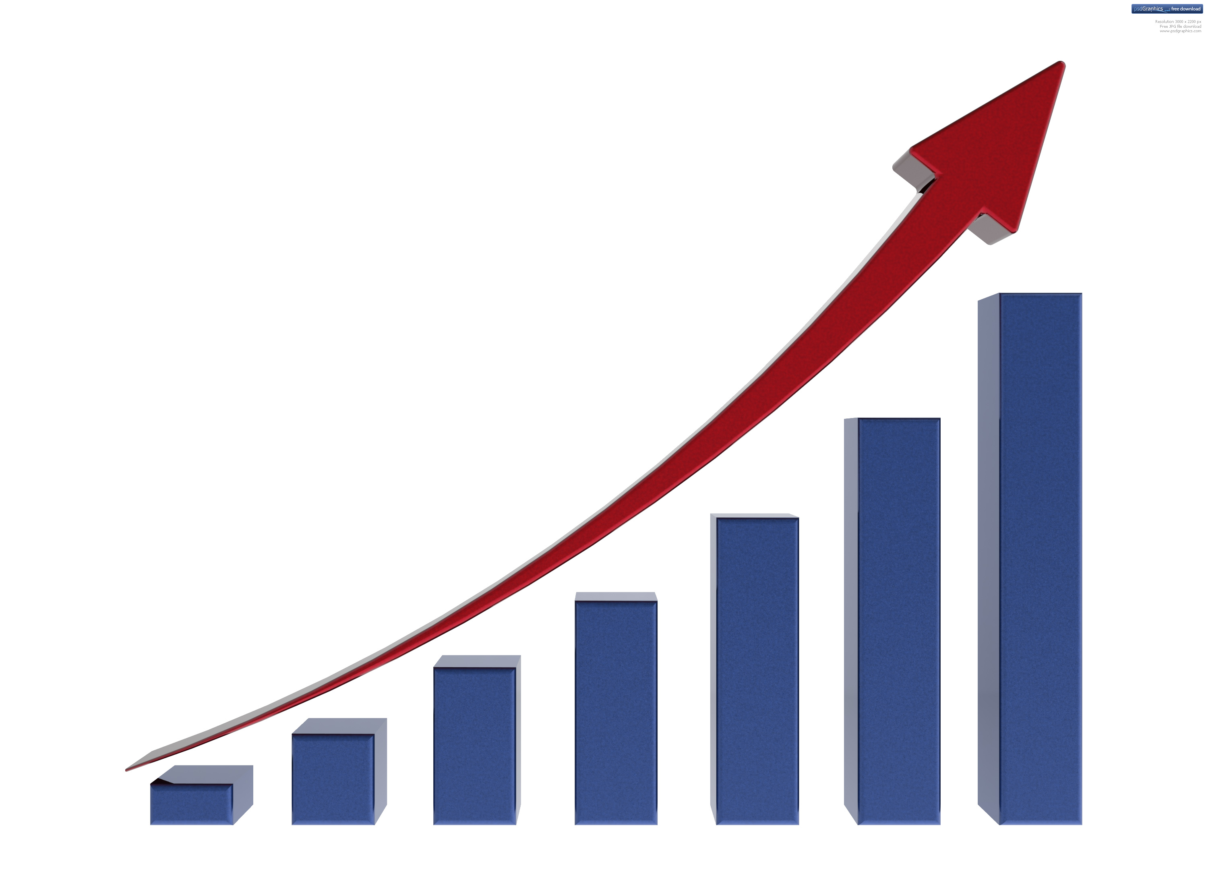
Performance of Enron
Revenues from trading activities
Highly competitive company culture
Stock price
Market capitalization
Market expectations

Slide 23
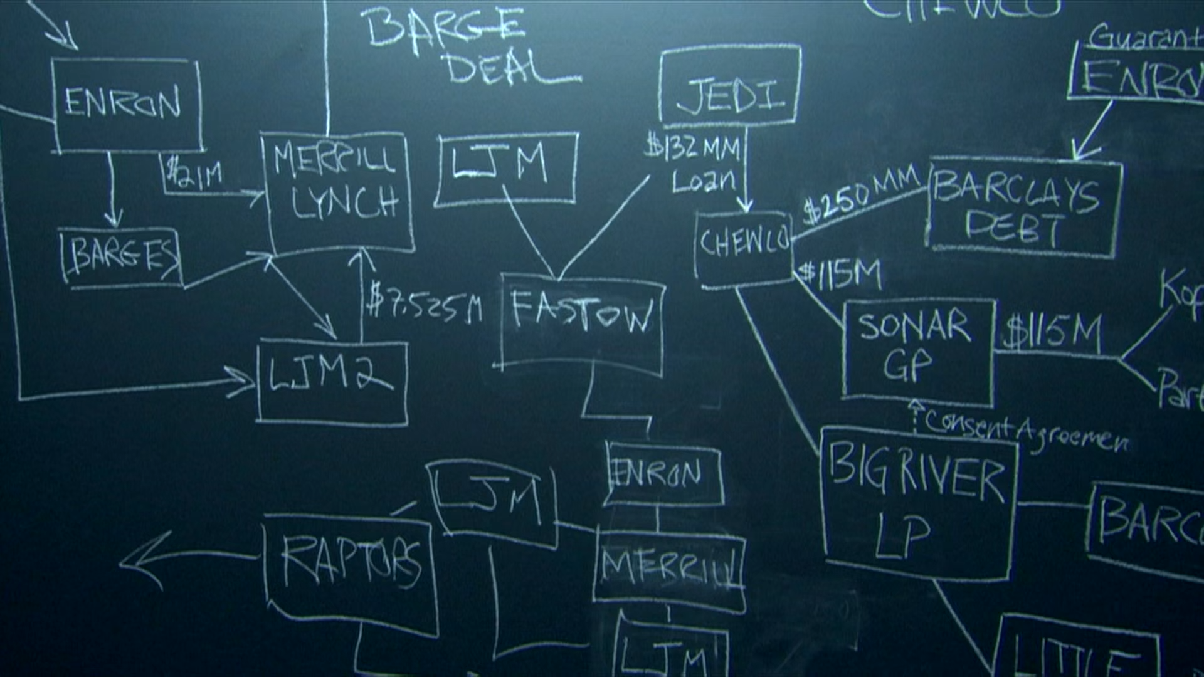
Off Balance Sheet Activities
Special Purpose Entities (SPE)
a subsidiary created by a parent company to isolate financial risk.
Structured Finance
Making Enron’s debt disappear
Chewco

Slide 24
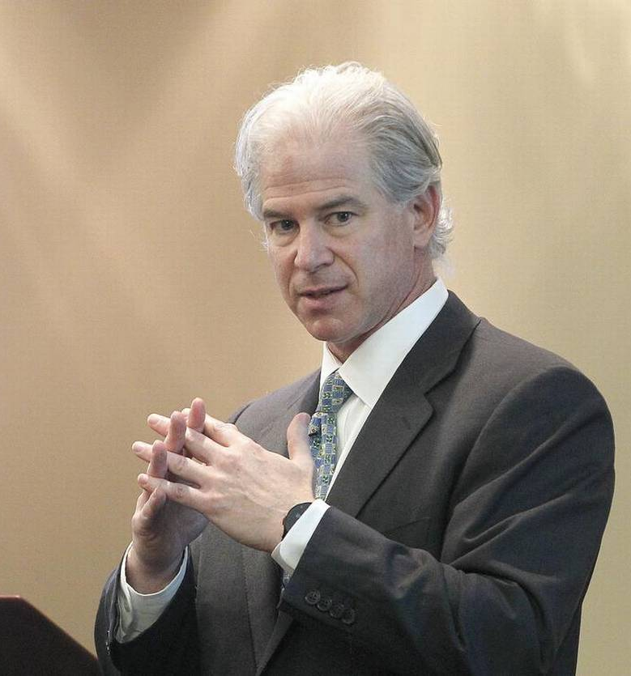
Andrew Fastow
Chief Financial Officer (CFO)
Moved Enron’s debt to his companies
LJM1, LJM2
Conflict of Interest
Made substantial profit out of these deals

Slide 25

California Electricity Crisis
“Deregulated electricity”
Manipulation of market
Exporting during shortages, then bringing back when prices increase
Shutting down power plants to create shortages
Betting on the price of electricity

Slide 26
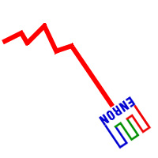
The Downfall
Problems in overseas operations
Short-selling of Enron stock
The article in Fortune “Is Enron Overpriced?”
Resignation of Skilling, Ken Lay took over
Letter of Sharon Watkins to Ken Lay
Fastow was fired
SEC investigation
Stock was downgraded

Slide 27
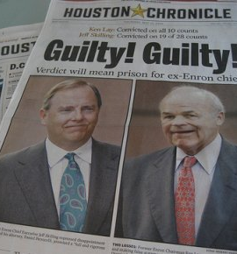
Aftermath
20,000 people lost their jobs
Employees lost $1.2 billion in retirement funds
Ken Lay, Jeffrey Skilling, and Andrew Fastow were indicted
Arthur Andersen was found guilty of obstructing justice
An executive of Enron, Cliff Baxter, committed suicide
Sarbanes-Oxley Act was signed
Financial Accounting Standards Board (FASB)

Slide 28
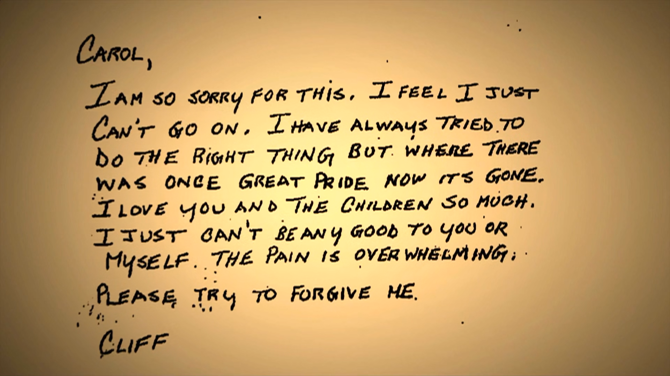

Slide 29
THANKS!

